Slide 1
Learning Objectives
• Create ladders.
• Insert a new ladder in the drawing.
• Modify an existing ladder.
• Understand the format referencing of ladders.

Slide 2
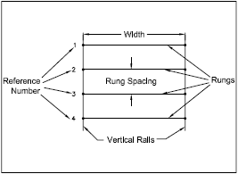
LADDERS
A collection of wires joined together to form a ladder-like matrix
Create the ladder type circuits easily by using the Insert Ladder and
Add Rung tools
Figure 1 Ladder and its components

Slide 3
Inserting a New Ladder
Ribbon: Schematic > Insert Wires/Wire Numbers > Insert Ladder drop-down >Insert Ladder
Toolbar: ACE:Main Electrical > Insert Ladder
or ACE:Ladders > Insert Ladder
Menu: Wires > Ladders > Insert Ladder
Command: AELADDER
Figure 2 The Insert Ladder drop-down

Slide 4
Figure 3 The Insert Ladder dialog box

Slide 5
Figure 4 The Insert Ladder dialog box with the 3 Phase radio button selected

Slide 6
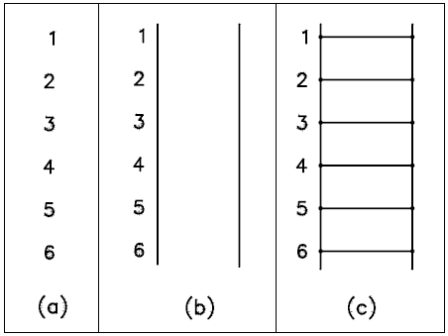
Figure 5 The ladder created by selecting (a) the No Bus radio button (b) the No Rungs radio button, and (c) the Yes radio button from the Draw Rungs area

Slide 7
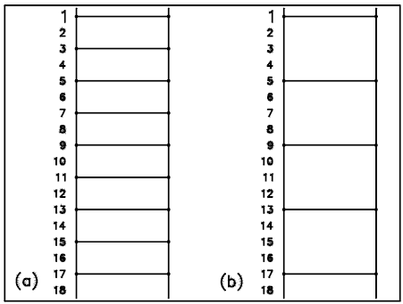
Figure 6 The ladder with 18 Rungs with (a) Skip = 1 and (b) Skip = 6

Slide 8
MODIFYING AN EXISTING LADDER
Renumbering an Existing Ladder
Ribbon: Schematic > Edit Wires/Wire Numbers > Modify Ladder drop-down > Revise Ladder
Toolbar: ACE:Main Electrical > Insert Ladder > Revise Ladder
or ACE:Ladders
Menu: Wires > Ladders > Revise Ladder
Command: AEREVISELADDER
Figure 7 The Modify Ladder drop-down

Slide 9
Figure 8 The Modify Line Reference Numbers dialog box

Slide 10
Changing the Size of a Ladder
Lengthening or Shortening a Ladder
Ribbon: Schematic > Edit Wires/Wire Numbers > Modify Ladder drop-down > Revise Ladder
Toolbar: ACE:Main Electrical > Insert Ladder > Revise Ladder
or ACE:Ladders > Revise Ladder
Menu: Wires > Ladders > Revise Ladder
Command: AEREVISELADDER

Slide 11
Figure 9 Selecting the ladder by using the crossing lasso

Slide 12
Widening or Compressing a Ladder
Ribbon: Schematic > Edit Components > Modify Components drop-down > Scoot
Toolbar: ACE:Main Electrical > Scoot
or ACE:Scoot > Scoot
Menu: Components > Scoot
Command: AESCOOT
Figure 10 The Modify Components drop-down

Slide 13
Repositioning a Ladder
Changing the Rung Spacing
Ribbon: Schematic > Edit Wires/Wire Numbers > Modify Ladder
drop-down > Revise Ladder
Toolbar: ACE:Main Electrical > Insert Ladder > Revise Ladder
or ACE:Ladders > Revise Ladder
Menu: Wires > Ladders > Revise Ladder
Command: AEREVISELADDER

Slide 14
Adding Rungs
Ribbon: Schematic > Edit Wires/Wire Numbers > Modify Ladder drop-down >Add Rung
Toolbar: ACE:Main Electrical > Add Rung
Menu: Wires > Add Rung
Command: AERUNG
Converting Line Reference Numbers
Ribbon: Conversion Tools > Tools > Convert Ladder
Toolbar: ACE:Conversion Tools > Convert Ladder
Menu: Wires > Ladders > Convert Ladder
or Projects > Conversion Tools > Convert Drawing > Convert Ladder
Command: AE2LADDER

Slide 15
Renumbering the Ladder Line Reference
Ribbon: Schematic > Edit Wires/Wire Numbers >
Add Rung > Renumber Ladder Reference
Toolbar: ACE:Main Electrical > Insert Ladder >
Renumber Ladder Reference
or ACE:Ladders > Renumber Ladder Reference
Menu: Wires > Ladders > Renumber Ladder Reference
Command: AERENUMBERLADDER

Slide 16
Figure 11 The Renumber Ladders dialog box

Slide 17
Changing the reference Numbering Style of a ladder
Figure 12 The Line Reference Numbers dialog box

Slide 18
Inserting X Grid Labels
Ribbon: Schematic > Insert Wires/Wire Numbers > Insert Ladder drop-down > X Zones Setup
Toolbar: ACE:Main Electrical > Insert Ladder > X Zone
or ACE:Ladders > X Zone
Command: AEXZONE
Figure 13 The AutoCAD Message message box

Slide 19
Figure 14 The X Zones Setup dialog box

Slide 20
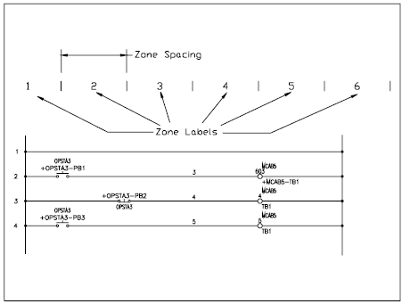
Figure 15 Zone labels and zone spacing

Slide 21
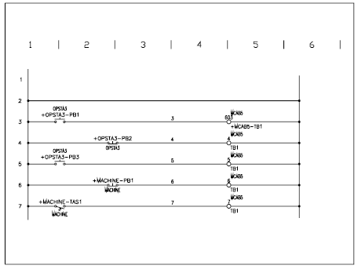
Figure 16 The ladder with X-Zone grid labels

Slide 22
Inserting X-Y Grid Labels
Ribbon: Schematic > Insert Wires/Wire Numbers > Insert Ladder drop-down > XY Grid Setup
Toolbar: ACE:Main Electrical > Insert Ladder > XY Grid
or ACE:Ladders > XY Grid
Command: AEXYGRID
Figure 17 The AutoCAD Message message box

Slide 23
Figure 18 The X-Y Grid Setup dialog box

Slide 24
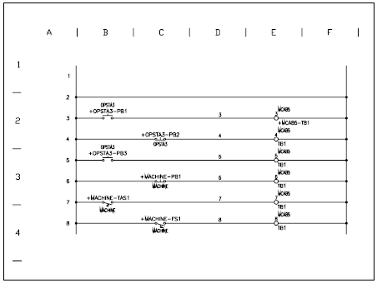
Figure 19 The ladder with X-Y grid setup

Slide 25
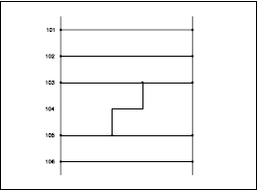
Tutorial 1
In this tutorial, you will insert a ladder into the drawing and then edit the ladder by trimming rungs. You will also add wires between rungs, as shown in Figure 20.
Figure 20 The ladder diagram for Tutorial 1

Slide 26
The following steps are required to complete this tutorial:
Open the drawing C02_tut02.dwg of the CADCIM project created in Tutorial 02 of Chapter 2.
Save the drawing as C04_tut01.dwg.
Add the drawing to the CADCIM project list.

Slide 27
4. Insert the ladder into the drawing.
Figure 21 The Insert Ladder dialog box

Slide 28
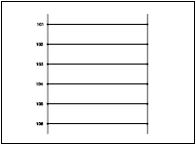
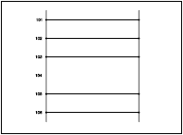
Trim ladder rungs.
Figure 22 The ladder inserted into the drawing
Figure 23 The ladder with trimmed rung

Slide 29
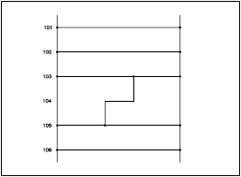
Add wires to the ladder.
Save and close the drawing file.
Figure 24 The ladder with the wire added

Slide 30
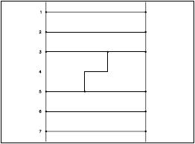
Tutorial 2
In this tutorial, you will stretch and revise the ladder that you created in Tutorial 1 of this chapter. Also, you will add rungs to the ladder, as shown in Figure 25.
Figure 25 The ladder diagram for Tutorial 2

Slide 31
The following steps are required to complete this tutorial:
Open the C04_tut01.dwg drawing file.
Save the drawing as C04_tut02.dwg.
Add the drawing to the CADCIM project list.

Slide 32
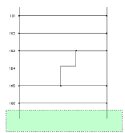
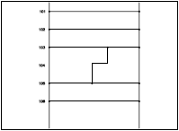
Stretch the ladder.
Figure 26 Selecting the ladder by using the crossing window
Figure 27 The stretched ladder

Slide 33
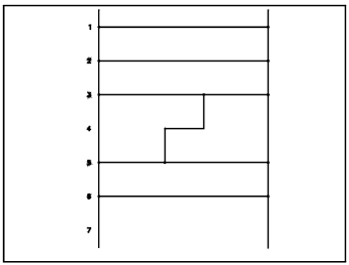
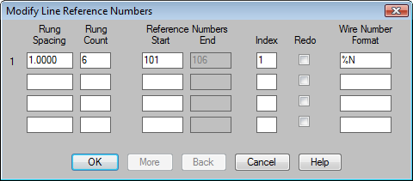
5. Revise the ladder
Figure 28 The Modify Line Reference Numbers dialog box
Figure 29 The revised ladder

Slide 34
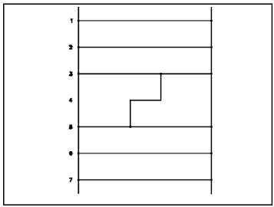
Add rungs to the ladder.
Save and close the drawing file.
Figure 30 A rung added to the ladder

Slide 35
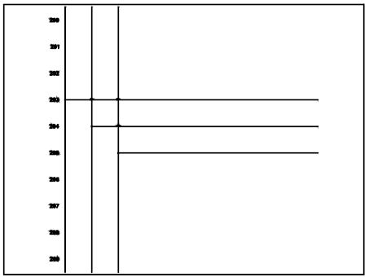
Tutorial 3
In this tutorial, you will insert a three-phase ladder and also add a three-phase wire bus to the drawing, as shown in Figure 31.
Figure 31 Three-phase ladder
and three-phase wire bus

Slide 36
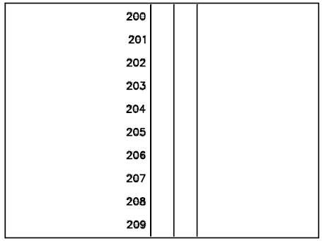
The following steps are required to complete this tutorial:
Create a new drawing C04_tut03.dwg in the CADCIM project.
2. Insert a three-phase ladder into the drawing.
Figure 32 Three phase ladder

Slide 37
3. Insert three-phase wire bus.
Figure 33 The Multiple Wire Bus dialog box

Slide 38
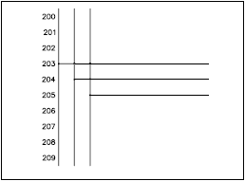
Figure 34 The ladder with three-phase wire bus
4. Save and close the drawing file.

Slide 39
Tutorial 4
In this tutorial, you will set the format for reference numbers of a ladder and then insert a ladder into the drawing. Next, you will insert another ladder and insert X-Y grid labels into the drawing, Refer to Figure 35.
The following steps are required to complete this tutorial:
Create a new drawing.
b. Set format for reference numbers.

Slide 40
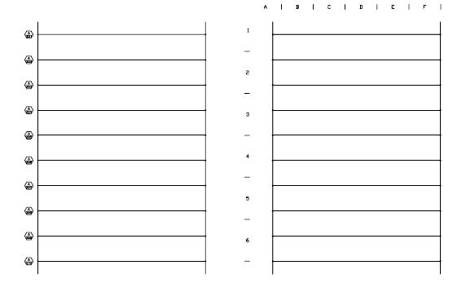
Figure 35 The ladder diagram for Tutorial 4

Slide 41
Figure 36 Choosing Drawing Properties from the shortcut menu

Slide 42
Figure 37 The Drawing Properties dialog box

Slide 43
Figure 38 The Line Reference Numbers dialog box

Slide 44
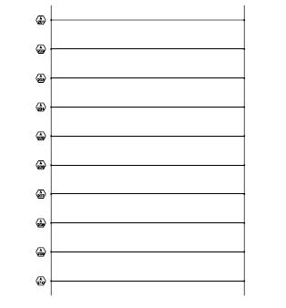
c. Insert a ladder into the drawing.
Figure 39 The inserted ladder

Slide 45
d. Insert X-Y grid labels into the drawing.
Figure 40 The X-Y Grid Setup dialog box

Slide 46
Figure 41 The X-Y Grid labels

Slide 47
e. Renumber Ladder Line Reference Numbers.
f. Save the drawing file.

